Slide 1
GUI Programming

Slide 2
GUI
There are two sets of java APIs for graphics programming: AWT (Abstract Window Toolkit) and Swing
AWT API was introduced in JDK 1.0. Most of the AWT components have become obsolete and should be replaced by newer Swing components.
Swing API, a much more comprehensive set of graphics libraries that enhances the AWT, was introduced as part of Java Foundation Classes (JFC) after the release of JDK 1.1.
Java Graphics APIs - AWT and Swing - provide a huge set of reusable GUI components, such as button, text field, label, choice, panel and frame for building GUI applications.

Slide 3
Things To Do…
Understand the hierarchy of AWT and swing APIs
Understand the basic components of GUI
And how to create them..

Slide 4
Containers and Components
There are two types of GUI elements:
Component: Components are elementary GUI entities ( such as Button, Label, Text Field)
Container: Containers ( such as Frame, Panel and Applet) are used to hold components in a specific layout. A container can hold sub containers
A swing application requires a top-level container.
There are three top-level containers in Swing
JFrame
JDialog
JApplet
Secondary containers such as JPanel is used to group components

Slide 5
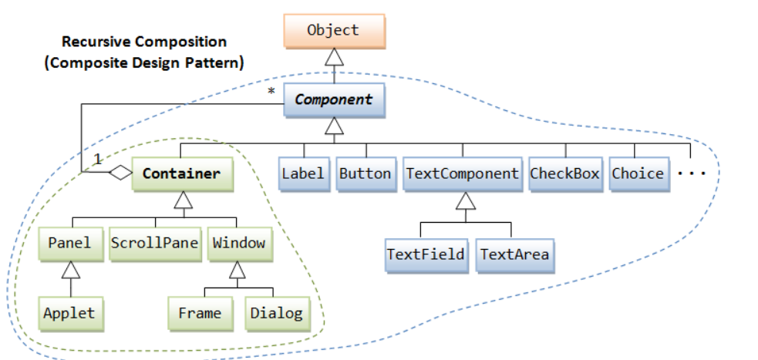
AWT

Slide 6
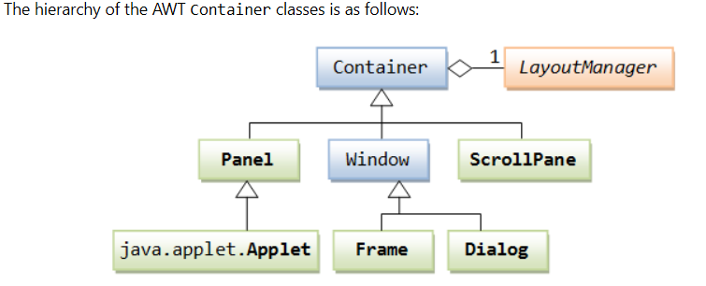
Hierarchy of the AWT Container Class

Slide 7
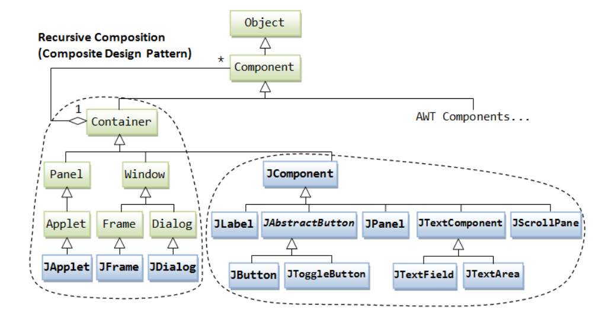

Slide 8
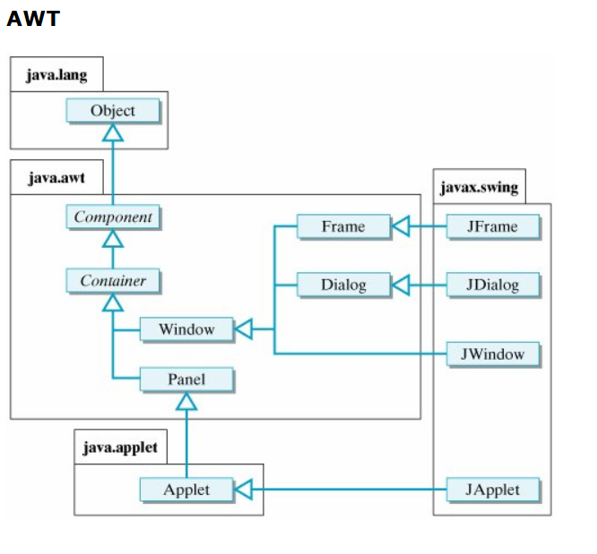

Slide 9
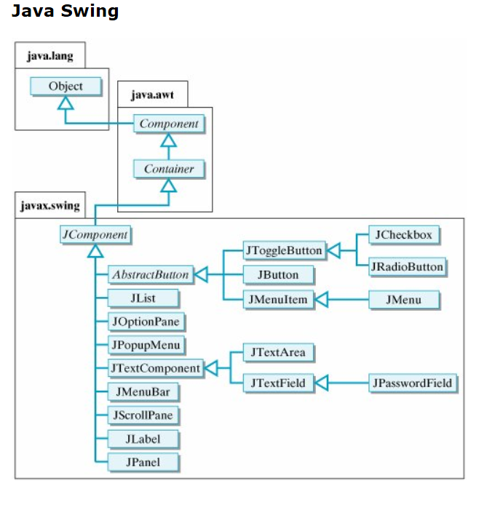

Slide 10
Components
Components and containers are at the core of Java graphics.
A component is a prebuilt part of a larger application
a button, a checkbox, a list, or a menu.
Components interact through events
clicking a button may cause a label to change
java.lang.Object
|
+--java.awt.Component

Slide 11
Containers
A container is a component that can embed other components.
It has a layout manager
Determines how the contained components are organized and arranged.
Because containers are components, containers can be nested inside of others.
java.lang.Object
|
+--java.awt.Component
|
+--java.awt.Container

Slide 12
The Content Pane
Unlike AWT, the JComponents shall not be added directly onto the top-level container (e.g. JFrame)
They should be added onto the content-pane of the top-level container.
Content-pane is in fact a java.awt.Container that can be used to group the components

Slide 13
The JFrame Container
Windows can be created using JFrame
Provides various methods to control attributes of a window
Height, width, visible, etc.
JFrame implements the interfaces:
Accessible
ImageObserver
MenuContainer
RootPaneContainer
Serializable
WindowConstants
java.lang.Object
|
+--java.awt.Component
|
+--java.awt.Container
|
+--java.awt.Window
|
+--java.awt.Frame
|
+--javax.swing.JFrame

Slide 14
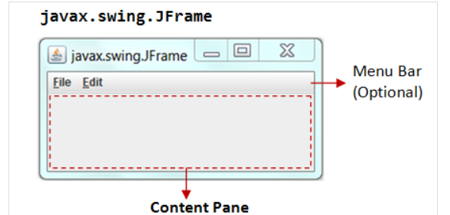
JFrame

Slide 15
Some JFrame Methods
JFrame()
Constructs a new frame that is initially invisible.
JFrame(String title)
Creates a new, initially invisible Frame with the specified title.
Container getContentPane()
Returns the contentPane object for this frame.
void setDefaultCloseOperation(int operation)
Sets the operation that will happen by default when the user initiates a "close" on this frame.
You must specify one of the following choices:
WindowsConstants.DO_NOTHING_ON_CLOSE
WindowsConstants.HIDE_ON_CLOSE
WindowsConstants.DISPOSE_ON_CLOSE
JFrame.EXIT_ON_CLOSE
void setLayout(LayoutManager manager)
By default the layout of this component may not be set, the layout of its contentPane should be set instead.

Slide 16
Adding items to the Content Pane
When we add items, how are they displayed?
Depends on the Layout Manager
Layout Manager
An object that controls the size and position (layout) of components inside a Container object.
setLayout method of Container
For swing containers, you want to getContentPane().setLayout() instead

Slide 17
Layout Managers
A container has layout manager to arrange its component
The following are the most common layouts
Flow Layout: Components are arranged from left to right inside the container. When one row is filled another is started
Grid Layout: Components are arranged in a matrix of rows and columns inside the Container
Border layout: The container is divided into 5 zones: EAST, WEST,NORTH, SOUTH, CENTER
Box Layout: Components are arranged in a single row or column.

Slide 18
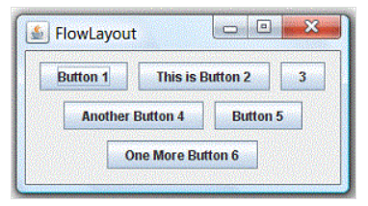
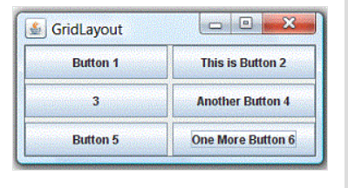
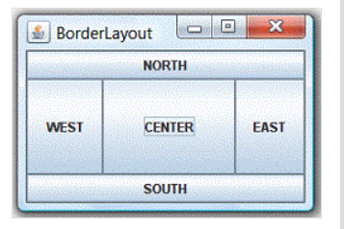
The Layouts

Slide 19
Flow Layouts
Default layout manager for all Panel objects and applets
Places components from left to right until no more items can be placed.
Order matters
Components are displayed at their preferred size

Slide 20
Using FlowLayout
Container c = getContentPane();
c.setLayout(new FlowLayout());
c.add(new JLabel("Flow Layout"));
c.add(new JButton("An extremely long name"));
c.add(new JButton("Short"));
c.add(new JButton("Medium Length"));
c.add(new JButton(“OK”));
c.add(new JScrollbar(Scrollbar.HORIZONTAL));

Slide 21
Grid Layout
Similar to FlowLayout
Order matters
All rows (columns) have same number of components
All components have the same size
Components will stretch to fill the space

Slide 22
c = getContentPane();
c.setLayout(new GridLayout(5,1));
c.add(new Label("Grid Layout 1 col."));
c.add(new Button("2 cols."));
c.add(new Button("3 cols."));
c.add(new Button("4 cols."));
c.add(new Button("OK"));

Slide 23
BorderLayout
Default LayoutManager for JFrame
Items placed into one of 5 specific regions
Can have only one item in each region
Need to use add(String, Component) or the add(Component, Object) methods
add(Component) method will place the item in the center
NORTH
WEST
CENTER
EAST
SOUTH

Slide 24
Container c = getContentPane();
c.setLayout(new BorderLayout());
JLabel dialogLabel = new Label("Border Layout");
dialogLabel.setAlignment(Label.CENTER);
JList items = new JList({"Apple tree", "Orange tree",
"Pear tree", "Peach tree", "Cherry tree",
"Apricot tree"});
c.add(items);
c.add("North", dialogLabel);
c.add("South", new JButton("OK"));
c.add("Center", items);

Slide 25
Box Layout
New as of version 1.2
Used for placing components from left to right or top to bottom in an AWT or Swing container.
Has an axis parameter
Specifies the type of layout that will be done
Choices:
X_AXIS - Components are laid out horizontally from left to right.
Y_AXIS - Components are laid out vertically from top to bottom.
LINE_AXIS - Components are laid out the way words are laid out in a line, based on the container's ComponentOrientation property. If the container's ComponentOrientation is horizontal then components are laid out horizontally, otherwise they are laid out vertically.
PAGE_AXIS - Components are laid out the way text lines are laid out on a page, based on the container's ComponentOrientation property. If the container's ComponentOrientation is horizontal then components are laid out vertically, otherwise they are laid out horizontally.

Slide 26
Components
JLabel – displays information which cannot be edited
Can show text messages and/or images (icons)
A label does not react to input events.
It cannot get the keyboard focus.
JLabel label = new JLabel(“Just text”);
java.lang.Object
|
+--java.awt.Component
|
+--java.awt.Container
|
+--javax.swing.JComponent
|
+--javax.swing.JLabel

Slide 27
JTextField
Allow the user to edit the value
Can be used for display only by changing whether or not the field is editable
setEditable(false)
Use JPasswordField for passwords
Masks input characters with a ‘*’
JTextField idTF = new JTextField(30);
java.lang.Object
|
+--java.awt.Component
|
+--java.awt.Container
|
+--javax.swing.JComponent
|
+--javax.swing.text.JTextComponent
|
+--javax.swing.JTextField

Slide 28
JTextArea
Can collect multiple lines of input from user
Can display multiple lines of output
Pressing Enter key separates lines of text
Each line ends with newline character ‘\n’
Derived from class JTextComponent
JTextArea ta = new JTextArea(5, 20);
java.lang.Object
|
+--java.awt.Component
|
+--java.awt.Container
|
+--javax.swing.JComponent
|
+--javax.swing.text.JTextComponent
|
+--javax.swing.JTextArea

Slide 29
JButton
Provided to create pushable buttons in Java
User pressing the button causes an event to occur
The program can respond to the user clicking the button (aka “handle the event”)
This is known as an ActionEvent
By default, clicking a button doesn’t do anything
You must register a listener for the button, which provides the code for what you want to occur upon a button click.

Slide 30
java.lang.Object
|
+--java.awt.Component
|
+--java.awt.Container
|
+--javax.swing.JComponent
|
+--javax.swing.AbstractButton
|
+--javax.swing.JButton
JButton okButton = new JButton(“OK”);

Slide 31
JComboBox
Lets the user choose one of several choices
2 types:
Not editable combo box
Has a button and a drop-down list of values
Editable combo box
Text field with a small button. The user can type a value in the text field or click the button to display a drop-down list.

Slide 32

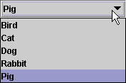
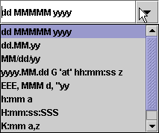
Not Editable and Editable

Slide 33
java.lang.Object
|
+--java.awt.Component
|
+--java.awt.Container
|
+--javax.swing.JComponent
|
+--javax.swing.JComboBox
JComboBox mealOptions = new JComboBox ({“chicken”, “mutton”, “egg”});

Slide 34
JList
Similar to JComboBox, but is always uneditable
Allows for more than one selection at a time
Can have more than one column
java.lang.Object
|
+--java.awt.Component
|
+--java.awt.Container
|
+--javax.swing.JComponent
|
+--javax.swing.Jlist
String[] data = {"one", "two", "three", "four"};
JList dataList = new JList(data);

Slide 35
JCheckBox
User selects from predefined values
Example of a toggle button
Clicking JCheckBox generates item event
java.lang.Object
|
+--java.awt.Component
|
+--java.awt.Container
|
+--javax.swing.JComponent
|
+--javax.swing.AbstractButton
|
+--javax.swing.JToggleButton
|
+--javax.swing.JCheckBox

Slide 36
JLabel langLabel=new JLabel("Language ");
JCheckBox c=new JCheckBox("C");
JCheckBox cpp=new JCheckBox("C++ ");
JCheckBox java=new JCheckBox("JAVA ");

Slide 37
JRadioButton
Similar to a JCheckBox
Is selected or not
Used with a ButtonGroup object to create a group of buttons in which only one button at a time can be selected.
This is a logical (not physical) grouping
java.lang.Object
|
+--java.awt.Component
|
+--java.awt.Container
|
+--javax.swing.JComponent
|
+--javax.swing.AbstractButton
|
+--javax.swing.JToggleButton
|
+--javax.swing.JRadioButton

Slide 38
JRadioButton yes;
yes = new JRadioButton(“yes”);
yes.setSelected(true);
JRadioButton no;
no = new JRadioButton(“no”);
ButtonGroup g = new ButtonGroup();
g.add(yes);
g.add(no);
getContentPane().add(yes);
getContentPane().add(no);

Slide 39
Creating a GUI
Import packages
Create a object of JFrame or extend the Jframe class
Create a content pane
Set a layout
Create the object of various components
Add the components to the content pane

Slide 40
Example
import java.awt.*;
import javax.swing.*;
class MyFrame extends JFrame {
MyFrame()
{
Container c=getContentPane();
c.setLayout(new GridLayout(1,2));
JLabel label1=new JLabel("this is a First Gui code ");
JLabel label2=new JLabel("This is a label");
JButton button1=new JButton("Okay");
//adding the label in the container
c.add(label1);
c.add(label2);
c.add(button1); }
public static void main(String [] at) {
MyFrame f=new MyFrame();
f.setSize(500,500);
f.setVisible(true);
f.setDefaultCloseOperation(EXIT_ON_CLOSE);
}
}

